Slide 1
AN AUTOMATED EMAIL SERVICE BY CONVERSATIONAL AI
GUIDED BY
Dr.G.Nalinipriya,M.E.,Ph.D.,
Professor,
Department of Information Technology,
Saveetha Engineering College.
SUBMITTED BY
Anandasayanam K 212219220002
Hariram B 212219220012
Maheswara Pandian G 212219220029

Slide 2
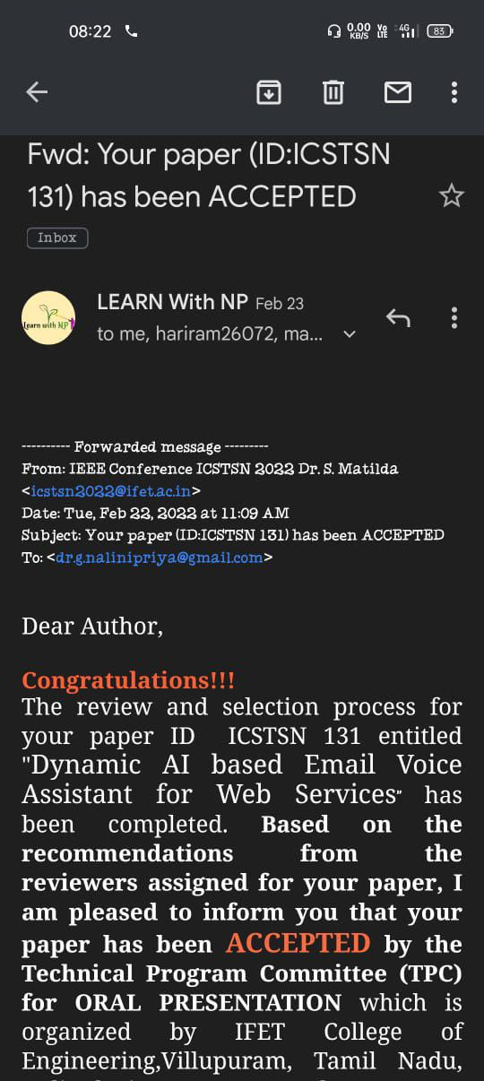
IEEE CONFERENCE ICSTSN
Our paper has been selected in international conference 2022 under the guidence of Dr.G Nalini Priya,M.E..,Ph.D

Slide 3
Agenda
Abstract
Scope of project
Literature survey
Existing system
Proposed system
System architecture
Modules
Result and discussion
Conclusion and future work
Reference
Thank you

Slide 4
ABSTRACT
In recent years, voice assistant has shown significant process and its potential is growing. And billions of devices that incorporates them in domestic nowadays. Then, to communicate with one another, Email is one of the most prevalent way.
Here we are targeting to establish an AI based email voice assistant system. The voice assistant listens to the user's voice input and converts it as a text and then sends it as an email message to the recipient.
Firstly, we have to provide user’s email id and its Gmail account’s password to authenticate and this can be executed using Python in PyCharm community IDE.

Slide 5
Scope of the project
This proposed system uses conversational artificial intelligence technique and it allows existing mail system to be replaced by modern solutions.
The sender should feel comfort to send mail to any recipient through this mail assistant.
It promotes the development of technology for future trends.

Slide 6
LITERATURE SURVEY
We had gone through many literature papers that used email voice assistant and certain literature paper were found related to the concept.
Harsh D Shah [1] et al. proposed a method in which user can send messages to the recipient where receiver’s email id is already programmed in the sender’s record. This paper is based on Automated Speech Recognition method. By using this method, a user can access their own account, with voice instruction.
Another paper by Sunny Kumar [2] et al. proposed a system in which a new email architecture system was created that can be needful to blind people to use the model for email purposes without any earlier execution.

Slide 7
Suresh Malodia [3] et al. inspects the different consumption principles corelated with the use of voice instruction. Mixed method approach were undertaken by “Theory of consumption values” (TCU).
In Another paper S . Subhash [4] et al.suggested a voice assistant can collect the speech from the mic and then changes it to wording. Then, that text can be sent via Google text-to-speech . The text is converted into audio file which is an English language, by GTTS engine. Finally, Python package plays the speech received from GTTS.

Slide 8
Sherly Noel [5] proposed a system to describe an algorithm which changes text-to-speech for looking through emails and also changes speech-to-text for composing an email. In this algorithm, for speech recognition, Application Programming Interface is applied.
Tae - Kook Kim [6] suggests an Artificial Intelligence (AI) based voice command assistant . In this model Application Programming Interface service, Google assistant and auto- execution syste
Georgios Germanos [7] et al. presented the location of individual data and types inside the environs of three famous assistants.m were designed.

Slide 9
Dengke Tang [8] et al. proposed three pattern mechanism under complete learning configuration. And they are (i) ResNet, (ii) Convolutional Neural Network (iii) Recurrent Neural Network + Convolutional Neural Network. Further, they also looked over various data enhancement, stabilize and illustrating methods, for improving performance of system.
Sadman Shahid Chowdary [9] et al. proposed the methods for developing a voice manipulated International Phonetic Alphabet, which can approach immediate instruction in two dialects: Bengali and English, to execute boring task for user.

Slide 10
EXISTIIG SYSTEM
Email servers accept, forward, deliver, and store messages. Neither their users nor their computers are required to be online simultaneously; they need to connect, typically to a mail server or a webmail interface to send or receive messages or download it. The users send text messages only by typing or forwarding.

Slide 11
PROPOSED SYSTEM
Compare to the other email models, the proposed model shows an edge over the existing system by giving voice commands to the email assistant.
The sender’s option is not restricted to one recipient also more recipients can be added in the surrounding code space.
The proposed technique make use of SMTP library and packages like pyttx3, pyaudio, speech recognition and microphone.

Slide 12
This method will reduce the need for the manual method of typing the email to a recipient. The Proposed model assists the users (sender ) for quick and secure mail transfer facilities.
The constraint of the proposed system is, the sender should enable the less secure app access in their Gmail account. Also, sender should provide account credentials

Slide 13
SYSTEM ARCHITECTURE
The entire purpose of the SMTP (Simple Mail Transfer protocol) is to permit software to transmit emails over the internet by a set of communication guidelines . The authenticate is used to check whether the given information are correct or not. Next slide explains proposed system architecture for email voice assistant.

Slide 14
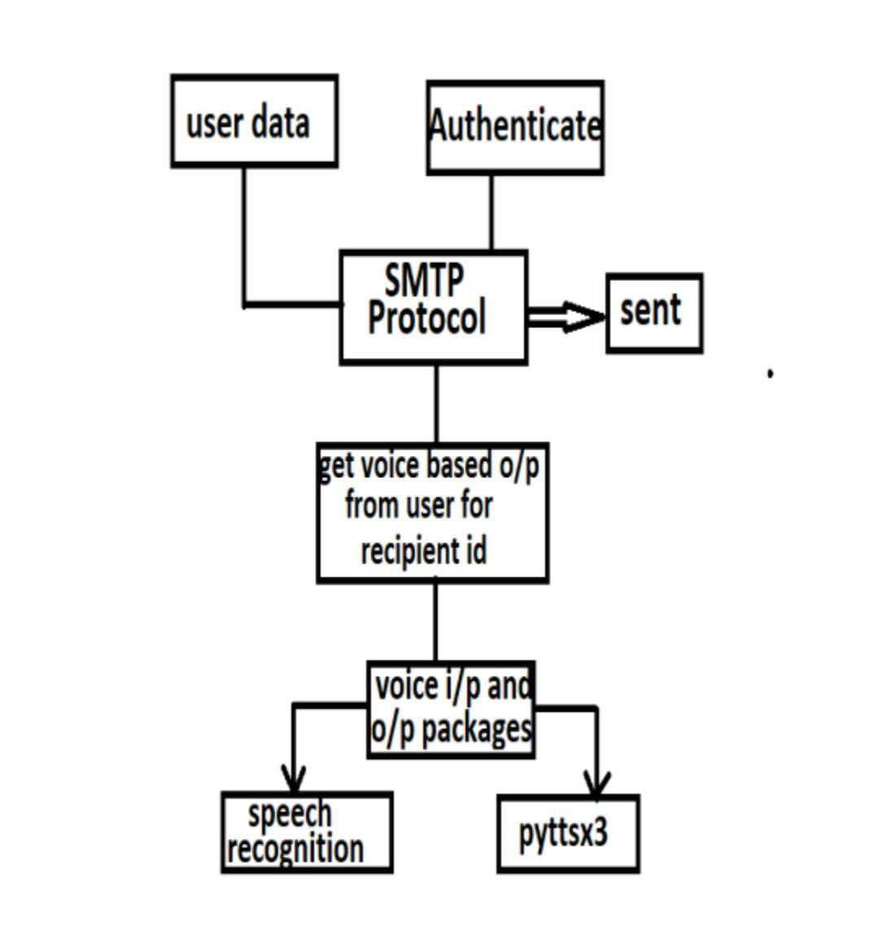

Slide 15
MODULES
A. User Data
The user's data means the data that the user sets up or possess. The user (sender) can send email to another user (recipient) only when he provide his email id and its own account password. He have to provide recipient list with their email id.
B. Authentication
Authentication is the method of confirming the recognition of user. After the user provides his data, his data is authenticated to check whether the given information are correct or not. Then, he have to disable “less secure app access” in Gmail settings. Then only, the email assistant has access to the user’s Gmail account.

Slide 16
C. SMTP PROTOCOL
The user has to import smtplib. Software is allowed to send emails over the internet with the use of SMTP (Simple Mail Transfer protocol) which is a protocol or a set of communication guidelines. On port number 587 (for encoded message) and 25 (for plain message), Transmission Control Protocol (TCP) is used by the servers of Simple Mail Transfer Protocol (SMTP).
D. Voice I/P O/P Packages
The voice input and output packages are used to identify the voice command of the user and perform respective actions to that command. The user has to install packages such as pyttsx3, Pyaudio and microphone. A given text message is converted to speech by pyttsx3 python package. The Python bindings for Portaudio is provided by Pyaudio package. The system can receive user’s voice input with the help of microphone package. The speechrecognition package can identify the user’s word and respond to spoken word.

Slide 17
Result and Discussion
The proposed model is a completely integrated AI deployed voice system with the assistance of Python. It allows the user to send email messages to a recipient through voice. The sender can interrelate with the email voice assistant and then assistant sends the information to the recipient.
smtplib has to be imported. Then, he have to install python packages such as pyttsx3, speechrecognition, PyAudio and microphone. He have to install all these packages through pip( Preferred Installer Program).

Slide 18
Compare to the other email models, the proposed model shows an edge over the existing system by giving voice commands to the email assistant.
The sender’s option is not restricted to one recipient also more recipients can be added in the surrounding code space.

Slide 19
Conclusion and Future work
Conversational Artificial Intelligence technique is used to improve this paper. This paper is not only for the normal people also visually challenged people can access this email system as it uses our voice only .
AI will be cheaper allowing the existing mail system to be replaced by various effective results in future.
This concept is totally based on interactive speech reply which makes it to feel efficient and convenient to use .

Slide 20
We have terminated the conception of keyboard shortcut usage, for decreasing logical load of recollecting shortcuts of keyboard. Any user who has lack of experience on systems and who doesn’t know the exact position of keys on keyboard need not to bother as utility of keyboard is terminated.
This paper is designed for enhancing the use of voice assistant in Gmail . The concept model can be further improved to suggest more convenient interface and more security, in future improvement.

Slide 21
REFERENCE
[1] Harsh D Shah, Amit Sundar, Shabnam Sharma . , “Controlling Email System Using Audio with Speech Recognition and Text to Speech” , IEEE 9th International Conference on Reliability, Infocom Technologies and Optimization ( Trends and Future Directions) (ICRITO), 2021.
2] Sunny Kumar , Yogitha R. , R. Aishwarya . , “Voice Email Based on SMTP For Physically Handicapped” , IEEE 5th International Conference on Intelligent Computing and Control Systems (ICICCS) , 2021.
[3] Suresh Malodia , Nazrul Islam , Puneet Kaur , Amandeep Dhir . , “Why Do People Use Artificial Intelligence (AI) - Enabled Voice Assistants ?” , IEEE Transactions on Engineering Management , 2021.

Slide 22
[4] S. Subhash, Prajwal N Srivatsa, S . Siddhesh, A . Ullas, B . Santhosh. , “Artificial Intelligence – based Voice Assistant”, IEEE , 2020.
[5] Sherly Noel . , “Human Computer interaction ( HCI ) based Smart Voice Email ( Vmail ) Application–Assistant for Visually Impaired Users ( VIU )” , IEEE , 2020.
[6] Tae - Kook Kim . , “Short Research on Voice Control System Based on Artificial Intelligence Assistant” , IEEE 2020 International Conference on Electronics Information, and Communication (ICEIC), 2020.

Slide 23
[7] Georgios Germanos, Dimitris Kavellieros, Nicholas Kolokotonis, Nikolas Georgiou . , “Privacy Issues in Voice Assistant Ecosystems”, IEEE 2020 IEEE World Congress on Services (SERVICES), 2020.
[8] Dengke Tang , Juplin Zeng , Ming Li., “An End-to-end Deep Learning Framework for Speech Emotion of Atypical Individuals”, Interspeech , pp; 162 – 166, 2018.
[9] Saadman Shahid Chowdary , Atiar Talukdar, Ashik Mahmud , Tanzilur Rahman. , “Domain Specific Intelligent Personal Assistant with Bilingual Voice Command Processing” , IEEE TENCON 2018- 2018 IEEE Region 10 Conference, 2018.

Slide 24
THANK YOU

